Slide 1
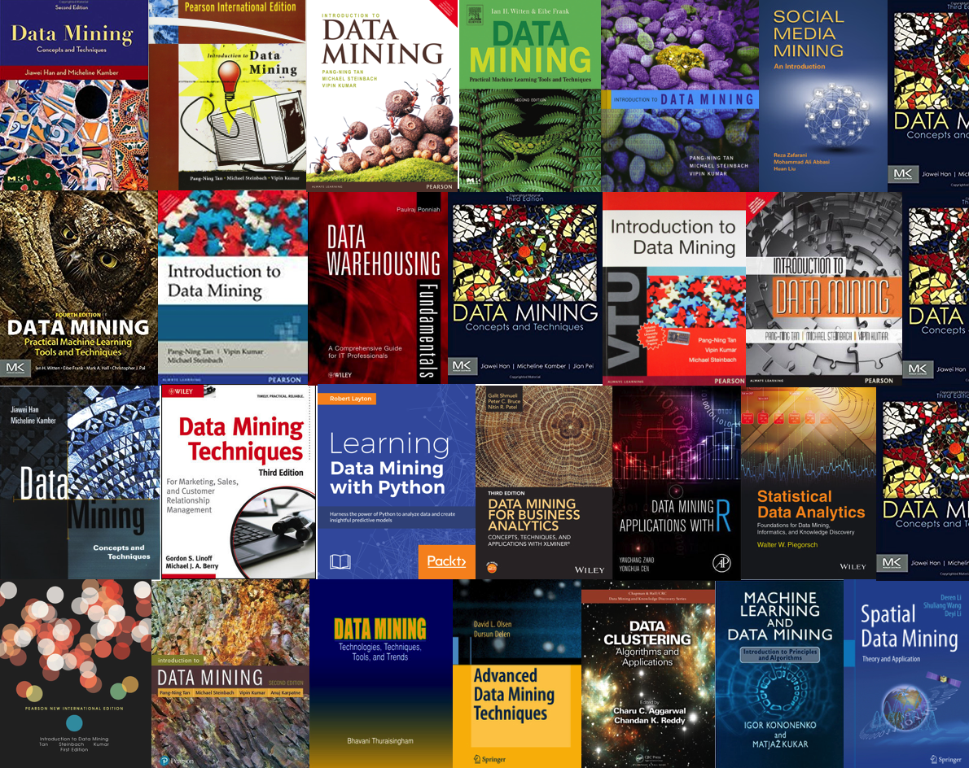
CSE 40647/60647
Data Science

Slide 2
Chapter 1. Introduction
Meng Jiang
Data Science

Slide 3






The Instructor
Dr. Meng Jiang (www.meng-jiang.com)
Visiting Ph.D.
B.S. and Ph.D.
Postdoc Researcher
Assistant Professor
Visiting Researcher
Visiting Researcher

Slide 4
Why do you take the course?
______________
______________
______________
______________
______________

Slide 5
General Learning Goals
Learn fundamental data science concepts
Learn basic methods for mining datasets
Prerequisites:
Programming skills with C++/Java/Python (at least one of them; MATLAB/R may not work for the course project)
Data structures (list, set, tree, stack, matrix, graph, etc.)
As a prerequisite for:
CSE 40625/60625: Machine Learning

Slide 6
Expect and Not Expect
Expect to have:
The first tiny step of being a “data scientist”
Don’t expect to have:
State-of-the-art machine learning/AI models
____________
____________
All skills that your start-up idea requires
____________
____________
____________

Slide 7
What is Data Science?
“...the process of automatically discovering useful information in large repositories of data.” — Introduction to Data Mining (Tan, Steinbach, & Kumar)
“...the process of discovering patterns in data.” — Data Mining: Practical Machine Learning Tools and Techniques, 3rd Edition (Witten, Frank, & Hall)
“...the process of discovering interesting patterns and knowledge from large amounts of data.” — Data Mining: Concepts and Techniques, 3rd Edition (Han, Kambler, & Pei)

Slide 8
Our Definition of the Course
“...the art and craft of extracting knowledge from large bodies of structured and unstructured data using methods from many disciplines, including (but not limited to) machine learning, databases, probability and statistics, information theory, and data visualization.”

Slide 9
What is/isn’t Data Science?
[ ] Looking up a record in a database.
[ ] Noting that some last names occur in certain geographical areas.
[ ] Searching for a term on Google.
[ ] Taking all query results from Google and discovering that they can be grouped or categorized.
[ ] Testing a two-sample hypothesis in a clinical trial.
[ ] When doing multiple tests across many different genes, identifying very strongly significant genes.

Slide 10
What is/isn’t Data Science?
[ × ] Looking up a record in a database.
No pattern is revealed by this lookup.
[ √ ] Noting that some last names occur in certain geographical areas.
[ × ] Searching for a term on Google.
This is simply a “match” or “non-match”.
[ √ ] Taking all query results from Google and discovering that they can be grouped or categorized.
[ × ] Testing a two-sample hypothesis in a clinical trial.
The dataset is often not large.
[ √ ] When doing multiple tests across many different genes, identifying very strongly significant genes.

Slide 11
Data Science Research
Datasets
Application Problems
Datasets
Application Problems
Data Cleaning
Data Integration
Informal Problem (Task) Def.
Task-Relevant Data Selection
Formal Problem Def.
Notations
Data Mining
Knowledge (patterns, descriptions, relations, etc.)
Pattern evaluation
Knowledge (patterns, etc.)

Slide 12
Example
Datasets: Walmart transaction data
Application Problems: Optimize products placement for more sales
Data Cleaning: Incomplete data, noisy data, etc.
Data Integration: Multiple operational databases (markets)
Informal Problem (Task) Def.: Given transactions, which two items are often purchased together?
Task-Relevant Data Selection: Input and validation data for a task
Formal Problem Def.: Given T = {T₁, …} and T_{i} ⊆X, find associations X_{j} → X_{k} that have high support and confidence.
Notations: Transaction set T, itemset/transaction T_{i}, the set of all the items X, items X_{j}
Data Mining: Propose an approach for association mining
Knowledge (patterns, etc.): The associations
Pattern evaluation: Sales increase?

Slide 13
Data Science Research
Datasets
Data Cleaning
Data Integration
Application Problems
Informal Problem (Task) Definition
Notations
What costs the most of time?
__________
__________
What is the most difficult?
__________
__________
What is engineering effort and what makes discovery?
__________
__________
Formal (Learning?) Problem Definition
Task-Relevant Data Selection
Data Mining/Machine Learning
Knowledge (patterns, etc.)
Pattern evaluation
Notes:
Ask good questions. Data engineering and data science.

Slide 14
Machine Learning
“A computer program is said to learn from experience, E, with respect to some class of tasks, T, and performance measure, P, if its performance at tasks in T, as measured by P, improves with experience, E.” — Tom Mitchell, Machine Learning
“Machine learning algorithms have proven to be of great practical value in a variety of application domains. They are especially useful in data mining problems...” — Tom Mitchell, Machine Learning

Slide 15
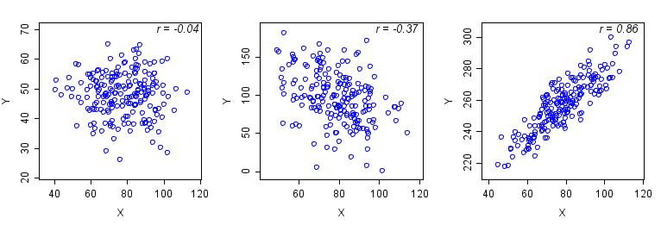
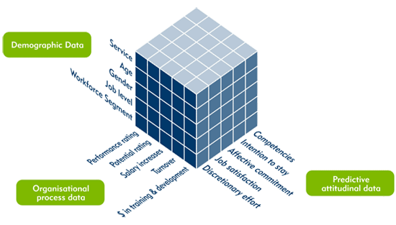
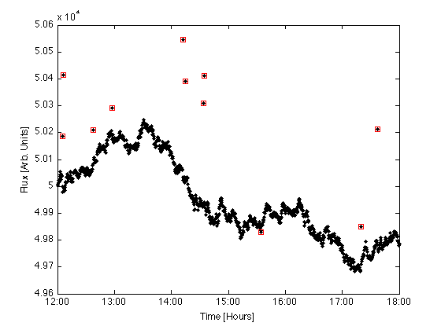
Data Science Functionalities
Generalization
Visualization
Frequent pattern mining and association mining
Classification
Clustering
Outlier analysis*

Slide 16
Concrete Learning Goals
Can process raw data: data cleaning, data integration, data reduction, dimension reduction
Can describe data cube concepts and technology that work on multi-dimensional data
Can use Apriori and FP-Growth for frequent pattern mining
Can describe diverse patterns, sequential patterns, graph patterns
Can use Decision Tree, Naïve Bayes, Ensembles for classification
Can describe SVMs and Neural Networks for classification
Can use K-Partitioning Methods (K-Means, etc.) for clustering
Can describe Kernel-based Clustering and Density-based Clustering
Can use appropriate measures to evaluate results of different functionalities

Slide 17
Syllabus and Schedule
08-22T | Introduction | 10-12R | Classification: Naïve Bayes
08-24R | Data description | 10-24T | Classification: Evaluation
08-29T | Data visualization | 10-26R | Classification: Ensembles
08-31R | Project introduction | 10-31T | Classification: SVMs
09-05T | Data cleaning and data integration | 11-02R | Classification: Neural networks
09-07R | Data reduction and dimension reduction | 11-07T | Clustering: Concepts
09-12T | Data cube: Concepts and operations | 11-09R | Clustering: Partitioning methods
09-14R | Data cube: Data warehouse and OLAP | 11-14T | Clustering: Kernel-based
09-19T | Frequent pattern mining: Apriori | 11-16R | Clustering: Density-based
09-21R | Frequent pattern mining: FP-Growth | 11-21T | Clustering: Evaluation
09-26T | Frequent pattern mining: Evaluation | 11-28T | Course review 2
09-28R | Frequent pattern mining: Beyond itemset | 11-30R | Course review 3
10-03T | Course review 1 | 12-05T | Project presentation 1
10-05R | Mid-term | 12-07R | Project presentation 2
10-10T | Classification: Decision tree induction | 12-12T | Final

Slide 18
Five Written Assignments and One Project
08-22T | Introduction | 10-12R | HW4 out
08-24R | Data processing | 10-24T
08-29T | HW1 out | 10-26R
08-31R | Project introduction Project out | 10-31T
09-05T |  | 11-02R
09-07R |  | 11-07T | Clustering
09-12T | Data cube HW1 due, HW2 out | 11-09R | HW4 due, HW5 out
09-14R |  | 11-14T
09-19T | Frequent pattern mining | 11-16R
09-21R | HW2 due, HW3 out | 11-21T
09-26T |  | 11-28T | Course review 2 HW5 due
09-28R |  | 11-30R | Course review 3 Project due
10-03T | Course review 1 HW3 due | 12-05T | Project presentation 1
10-05R | Mid-term | 12-07R | Project presentation 2
10-10T | Classification | 12-12T | Final

Slide 19
Grading
Uniform grading policy for undergraduates
HWs: 30% = 6% * 5
Project: 20% (Graduates are graded separately: expect more – workshop-quality paper?)
“Data science research bot”
Fed with thousands of data science publications
Knowledge discovery: Help data scientists on their research:
Extract “methods”, “problems”, “datasets”, etc., from the data.
Find state-of-the-art methods for a research problem.
Find new problem that can be solved by an existing method.
Find new methodology to an existing problem.
Subtasks:
Data cube, Frequent pattern mining, Classification, Clustering, etc.
Mid-term: 20%
Final: 30%
No quiz. No attendance requirement.

Slide 20
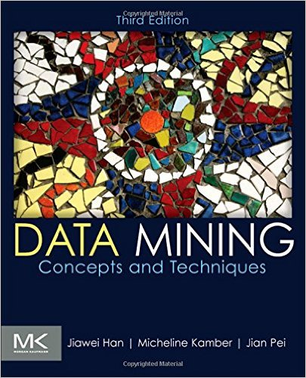
Textbook
Jiawei Han, Micheline Kamber and Jian Pei, Data Mining: Concepts and Techniques (3rd ed.), Morgan Kaufmann, 2011
Our lecture does not cover all the content of the book.
We publicize lecture notes of 2nd ed. of the book.

Slide 21
Time and Location
Lecture: 2:00 pm – 3:15 pm (Tuesday and Thursday), DeBartolo Hall 140
Office hour: 3:30 pm – 4:30 pm (Thursday), Cushing Hall 326C
Teaching Assistant: Qi Li (qli8)
TA hour: Tuesday?
Website (slides): ?
Forum: (Piazza) https://piazza.com/class/j6dmfs52c6d5ov
Grading: Sakai?

Slide 22
References
Charu C. Aggarwal, Data Mining: The Textbook, Springer, 2015
E. Alpaydin. Introduction to Machine Learning, 2nd ed., MIT Press, 2011
R. O. Duda, P. E. Hart, and D. G. Stork, Pattern Classification, 2ed., Wiley-Interscience, 2000
U. Fayyad, G. Grinstein, and A. Wierse, Information Visualization in Data Mining and Knowledge Discovery, Morgan Kaufmann, 2001
J. Han, M. Kamber, and J. Pei, Data Mining: Concepts and Techniques. Morgan Kaufmann, 3rd ed. , 2011
T. Hastie, R. Tibshirani, and J. Friedman, The Elements of Statistical Learning: Data Mining, Inference, and Prediction, 2nd ed., Springer, 2009
T. M. Mitchell, Machine Learning, McGraw Hill, 1997
P.-N. Tan, M. Steinbach and V. Kumar, Introduction to Data Mining, Wiley, 2005 (2nd ed. 2016)
I. H. Witten and E. Frank, Data Mining: Practical Machine Learning Tools and Techniques with Java Implementations, Morgan Kaufmann, 2nd ed. 2005
Mohammed J. Zaki and Wagner Meira Jr., Data Mining and Analysis: Fundamental Concepts and Algorithms 2014

